Slide 1
EE746 Neuromorphic Engineering Lecture 2c: Neuron Model
Udayan Ganguly
udayan@ee.iitb.ac.in
Jan, 31, 2020
Lectures follow https://neuronaldynamics.epfl.ch/online/index.html
Chapter 2: Neuron Models in Neural Computation by MATLAB book;
Please read;

Slide 2
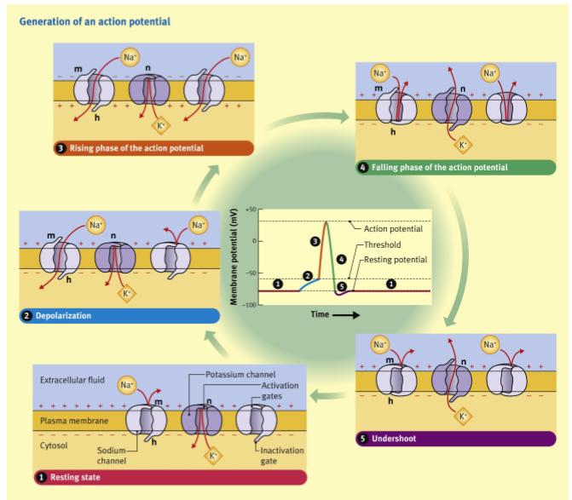
Next Step
Develop Mathematical model for Spiking Neuron

Slide 3
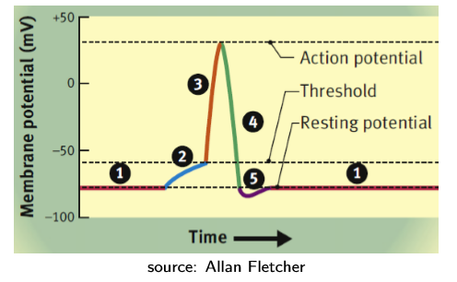
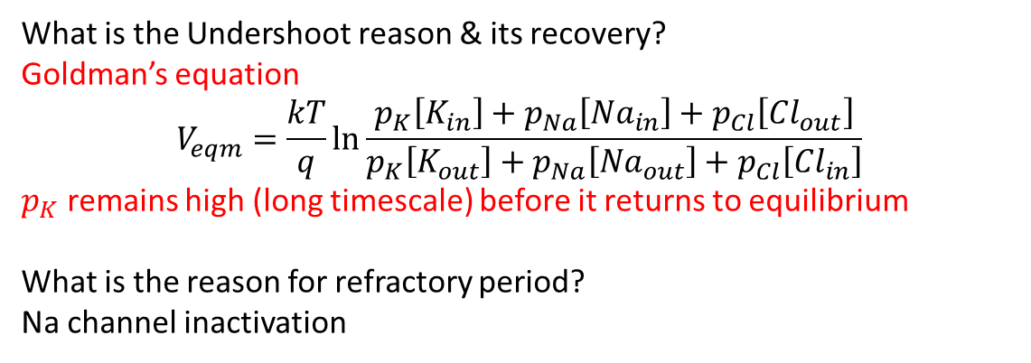
Undershoot and Refractory Period
What is the Undershoot reason & its recovery?
Goldman’s equation
$$V_{eqm}=\frac{kT}{q}\ln{\frac{p_{K}\left[K_{in}\right]+p_{Na}\left[{Na}_{in}\right]+p_{Cl}\left[{Cl}_{out}\right]}{p_{K}\left[K_{out}\right]+p_{Na}\left[{Na}_{out}\right]+p_{Cl}\left[{Cl}_{in}\right]}}$$
$p_{K}$ remains high (long timescale) before it returns to equilibrium
What is the reason for refractory period?
Na channel inactivation

Slide 4
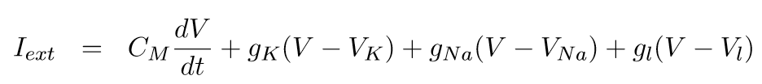
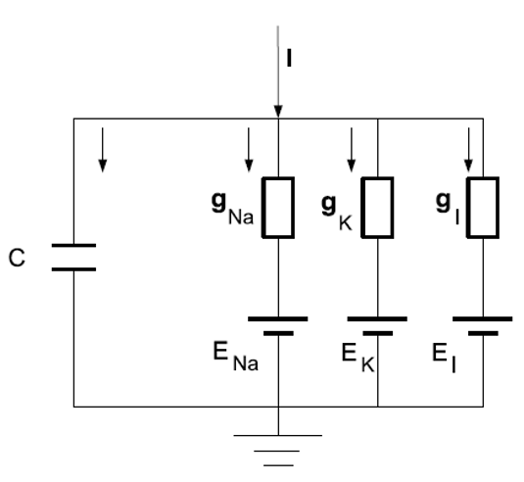
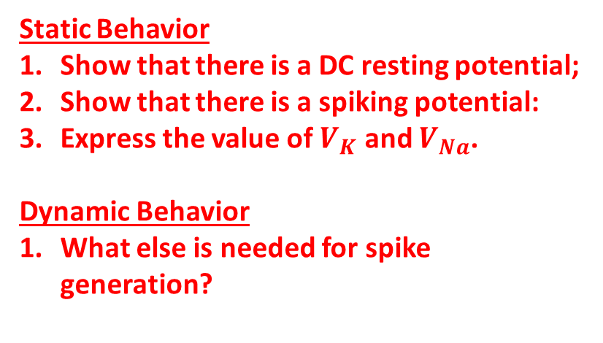
Hodgkin Huxley Model: Resting
Static Behavior
Show that there is a DC resting potential;
Show that there is a spiking potential:
Express the value of $V_{K}$ and $V_{Na}$.
Dynamic Behavior
What else is needed for spike generation?

Slide 5
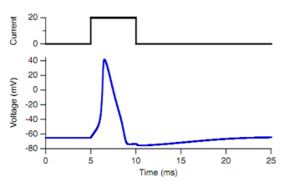
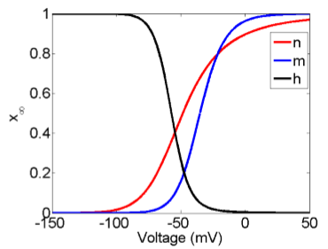
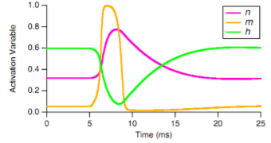
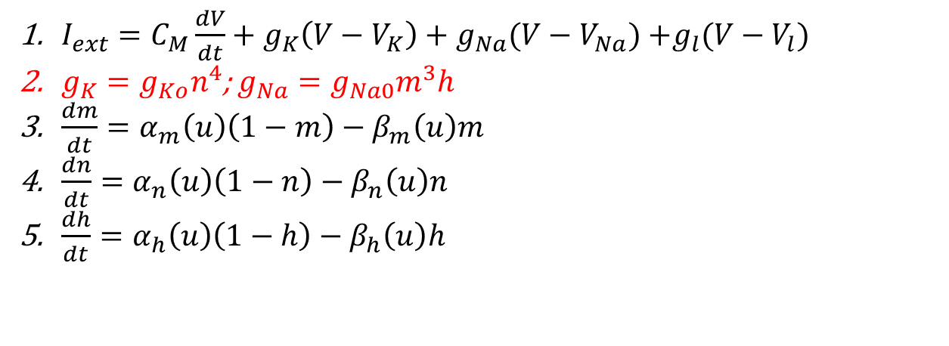
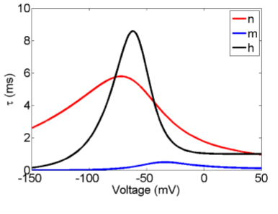
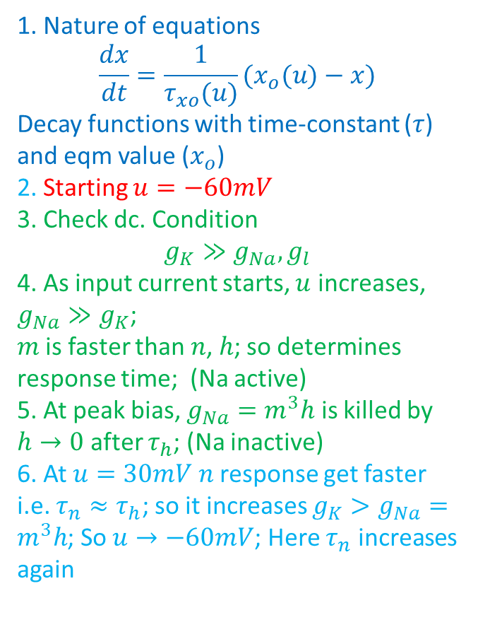

Hodgkin Huxley Model: Dynamic
1. Nature of equations [2-5]
2. Any further information needed?
Starting u=-60mV Check dc. Condition
4. As input current starts, should voltage rise?
5. At peak bias, should the current fall?
6. Should it go back to resting potential?
Can you find a method to figure out the threshold of the positive feedback
$I_{ext}=C_{M}\frac{dV}{dt}+g_{K}\left(V−V_{K}\right)+g_{Na}(V−V_{Na})$ $+g_{l}(V−V_{l})$
$g_{K}=g_{Ko}n^{4}$; $g_{Na}=g_{Na0}m^{3}h$
$\frac{dm}{dt}=α_{m}\left(u\right)\left(1−m\right)−β_{m}\left(u\right)m$
$\frac{dn}{dt}=α_{n}\left(u\right)\left(1−n\right)−β_{n}\left(u\right)n$
$\frac{dh}{dt}=α_{h}\left(u\right)\left(1−h\right)−β_{h}\left(u\right)h$
1. Nature of equations
$$\frac{dx}{dt}=\frac{1}{τ_{xo}(u)}(x_{o}(u)−x)$$
Decay functions with time-constant ($τ$) and eqm value ($x_{o}$)
2. Starting $u=−60mV$
3. Check dc. Condition
$$g_{K}≫g_{Na}, g_{l}$$
4. As input current starts, $u$ increases, $g_{Na}≫g_{K}$;
$m$is faster than $n$, $h$; so determines response time; (Na active)
5. At peak bias, $g_{Na}=m^{3}h$ is killed by $h→0$ after $τ_{h}$; (Na inactive)
6. At $u=30mV$ $n$ response get faster i.e. $τ_{n}≈τ_{h}$; so it increases $g_{K}>g_{Na}=m^{3}h$; So $u→−60mV$; Here $τ_{n}$ increases again

Slide 6
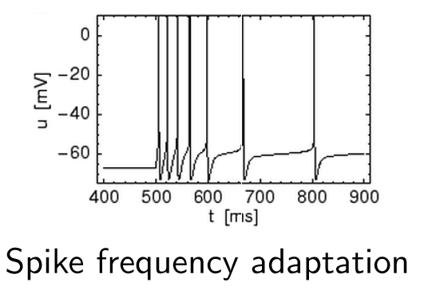
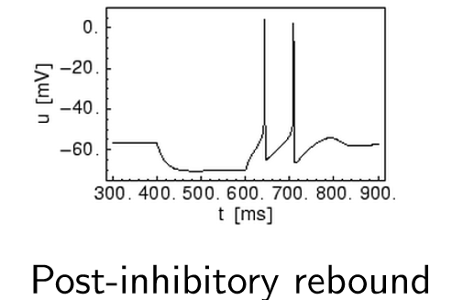
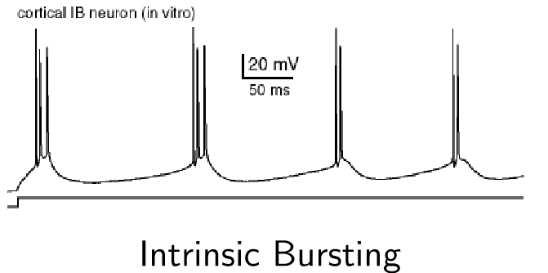
Computational Implementations
Leaky Integrate and Fire
Izhikevich Neuron
Adaptive Exponential LIF Neuron
Various behavior needs to be modeled for computational efficiency & behavioral fidelity

Slide 7
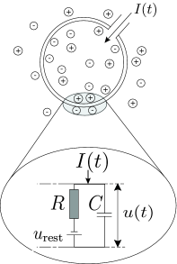


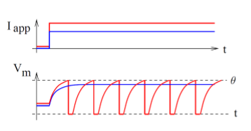
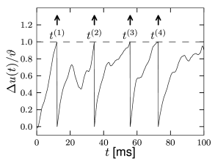

Leaky Integrate and Fire
http://neuronaldynamics.epfl.ch/online/Ch1.S3.html
Time of firing
Reset : $u\left(t\right)→u_{rest}$
(a)
(b)
Is it possible for no spiking to occur with finite input current? What is the max value?
What will happen for 3 linearly increasing DC inputs which are above threshold? Plot frequency vs. input current
What is the difference between input current of (a) vs (b)

Slide 8
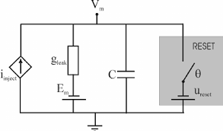


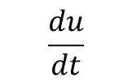


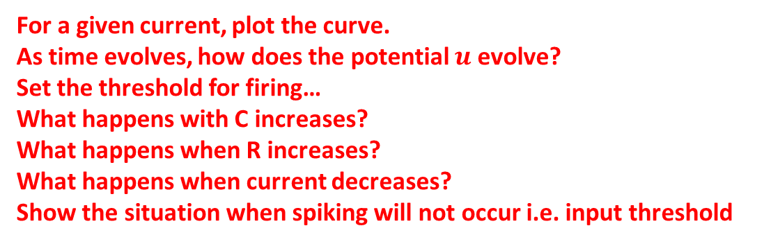


Leaky Integrate and Fire
http://neuronaldynamics.epfl.ch/online/Ch1.S3.html
$$u$$
Time of firing
R
Reset : $u\left(t\right)→u_{rest}$
$$I(t)$$
$$u_{rest}$$
$$\frac{du}{dt}$$
$$u_{rest}$$
For a given current, plot the curve.
As time evolves, how does the potential $u$ evolve?
Set the threshold for firing…
What happens with C increases?
What happens when R increases?
What happens when current decreases?
Show the situation when spiking will not occur i.e. input threshold
$$u_{rest}$$
$$u$$

Slide 9
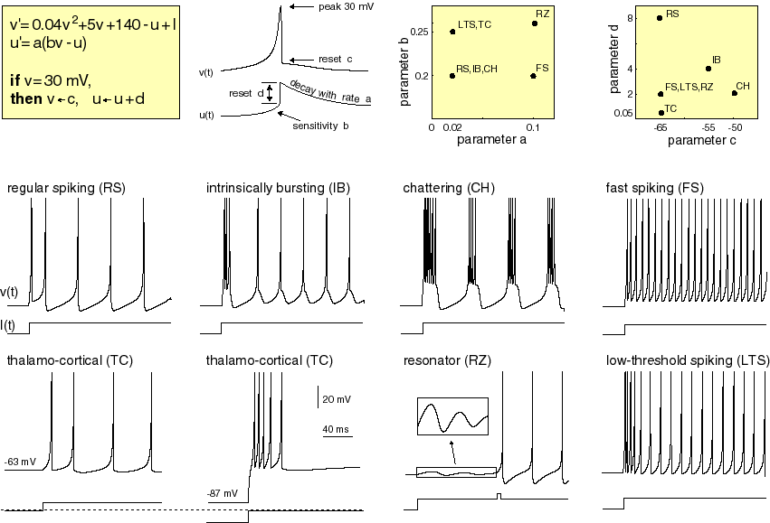
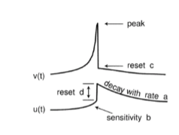
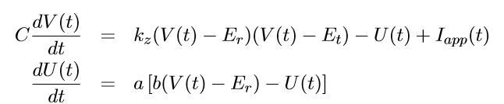

Izhikevich Neuron

Slide 10


Izhikevich Neuron
$$U$$
The neuronal equations are essentially oscillatory i.e. they spike & externally reset where U,V time evolves
Let us understand this time evolution
Draw steady state V,U plot for individual equations
Find the simultaneous steady state points
Which way will green points move?
Which way will blue points move?
Which is stable equilibrium point? Which is unstable?
x
x
q
+
+
+
p
$$V$$
x

Slide 11
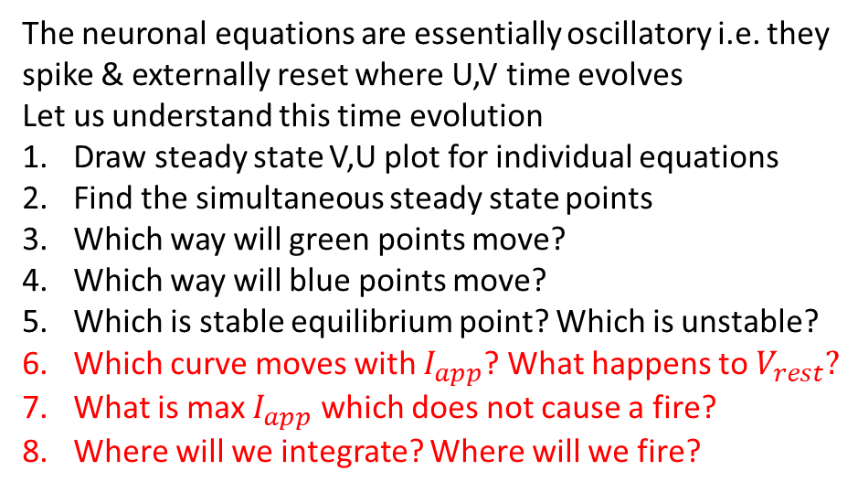
Izhikevich Neuron
$$U$$
The neuronal equations are essentially oscillatory i.e. they spike & externally reset where U,V time evolves
Let us understand this time evolution
Draw steady state V,U plot for individual equations
Find the simultaneous steady state points
Which way will green points move?
Which way will blue points move?
Which is stable equilibrium point? Which is unstable?
Which curve moves with $I_{app}$? What happens to $V_{rest}?$
What is max $I_{app}$ which does not cause a fire?
Where will we integrate? Where will we fire?
$$V$$

Slide 12
Izhikevich Neuron- “Generality”
Changing a,b, c, d; all behaviors can be observed

Slide 13
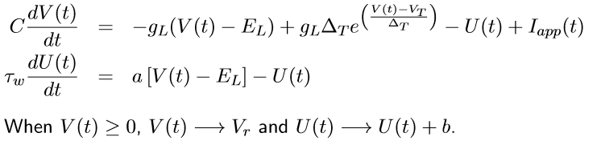
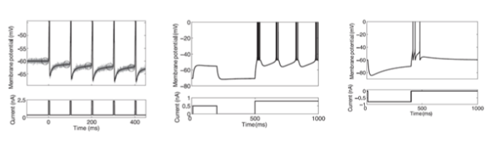


Adaptive Exponential Integrate and Fire Neuron
$$U$$
Let us understand this time evolution
Draw steady state V,U plot for individual equations
Find the simultaneous steady state points
Which way will green points move?
Which way will blue points move?
Which is stable equilibrium point? Which is unstable?
Where will we integrate? Where will we fire?
$$V$$

Slide 14
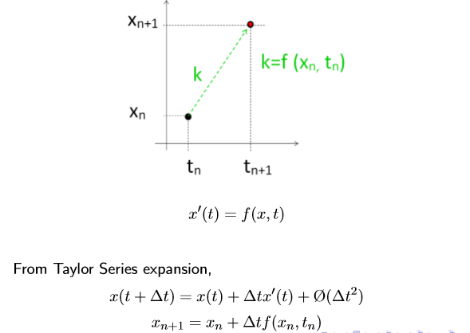
Forward Euler Method for solving Differential Equations
Given
and starting point x(t=0)
How do we find the line x(t)?

Slide 15
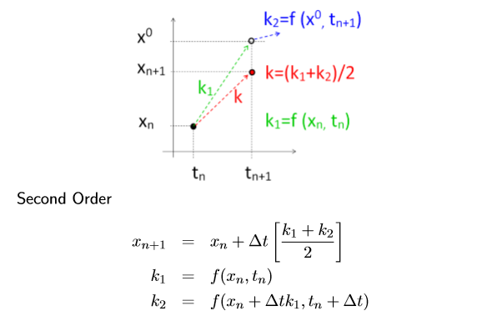
Runge ( ʀʊŋə) Kutta (kʊta) method

Slide 16
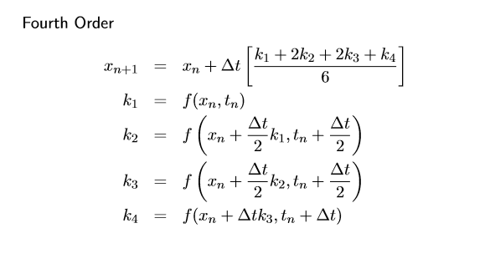
4th order Runge Kutta

Slide 17
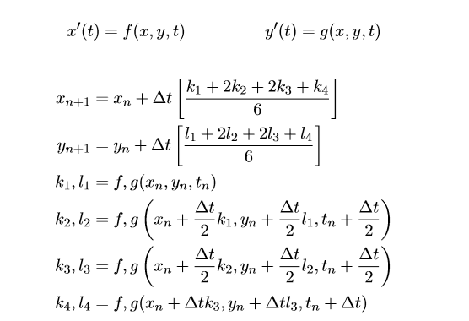
RK method for Simultaneous Diff. Eqn

Slide 18
Next, we do noise models in neurons

